Slide 1
Instructions for How to Complete UMC CITI Training

Slide 2
The UMC IRB requires a valid CITI Completion Certificate for Biomedical Research – Basic Course.
The University Medical Center Institutional Review Board has partnered with the Collaborative Institutional Training Initiative (CITI) Web-based Training Program to offer a course in Human Subjects Research Education. The UMC IRB requires that any Investigator, Resident, Research Administrator, Clinical Research Administrator, or other personnel listed on the protocol to complete this course in order to be able to participate in the research.
There is no requirement for CITI with quality improvement, practice improvement, or evidence-based practice projects.
Please follow the instructions below:

Slide 3
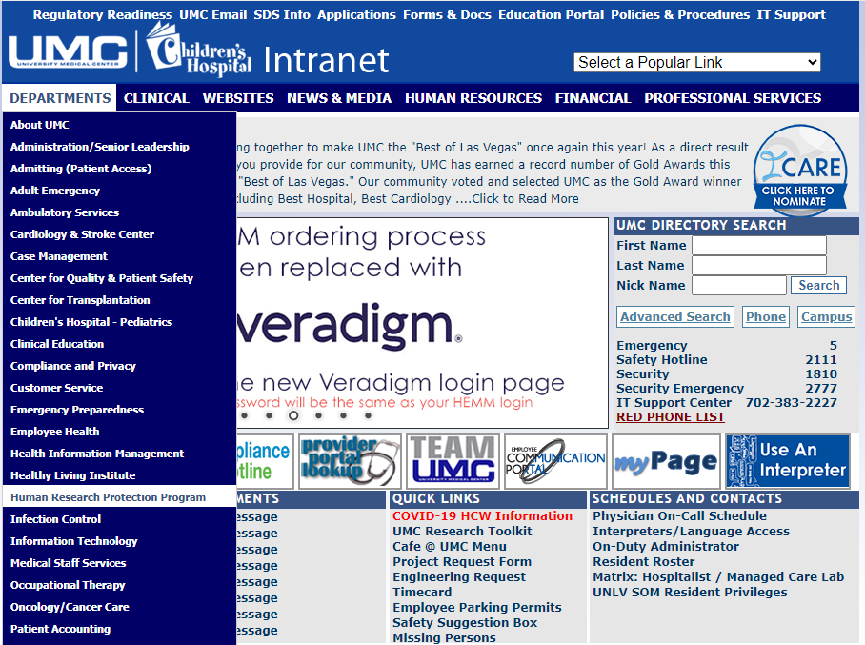
Go to UMC intranet and under Departments – select Human Research Protection Program.

Slide 4
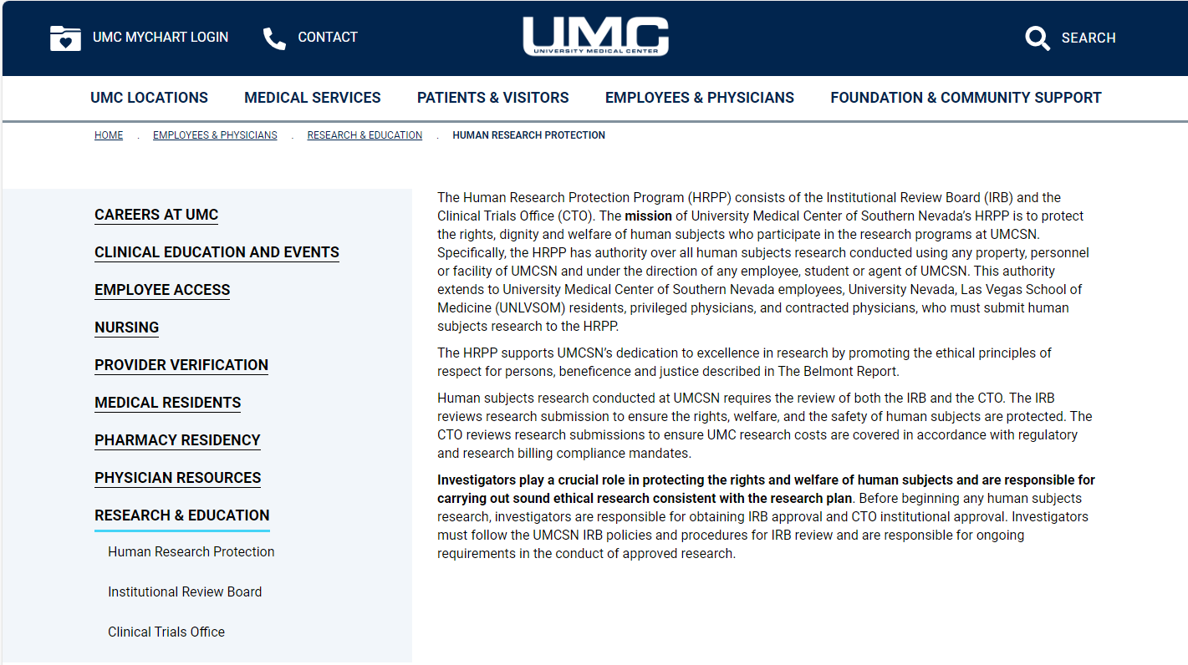
Under Research & Education – select Institutional Review Board.

Slide 5
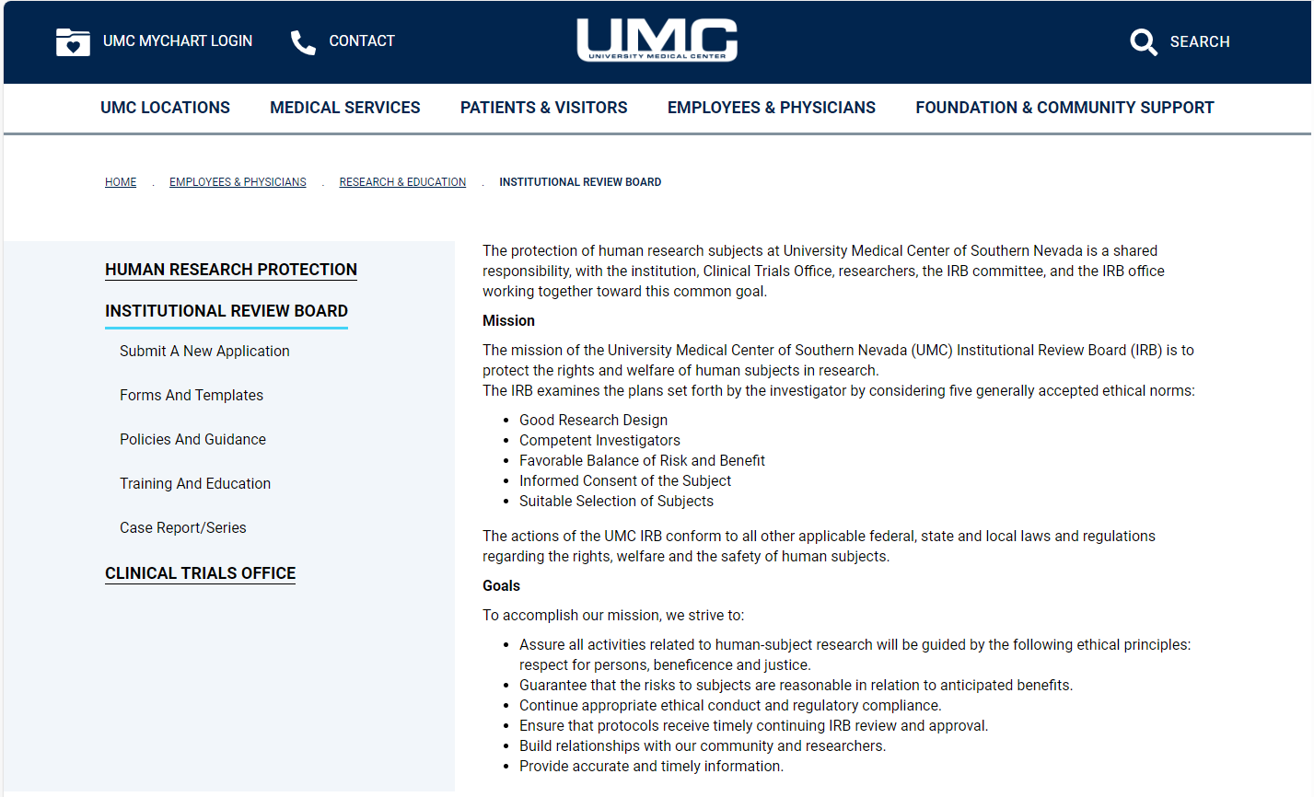
Under Institutional Review Board – select Training and Education.

Slide 6
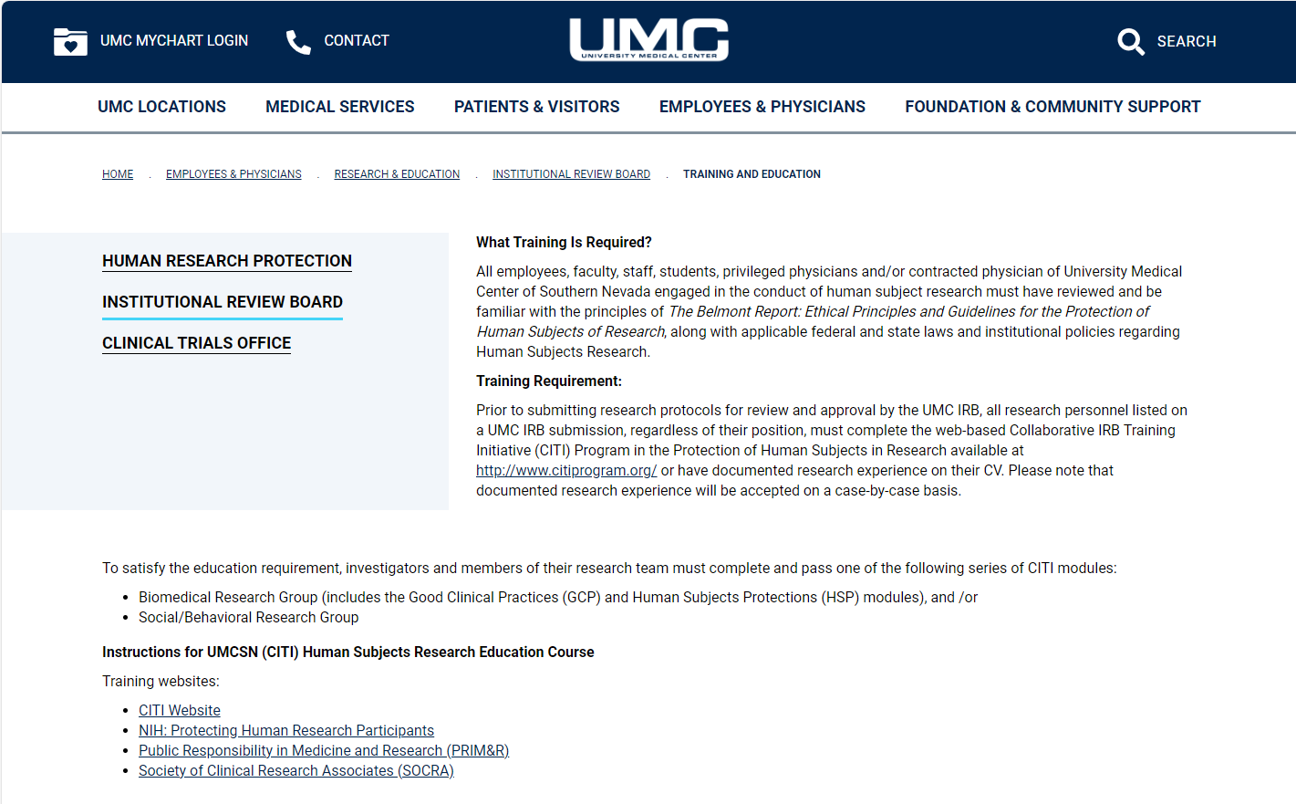
Follow the instructions on this page. Read this page carefully to determine what training is required. The link to the CITI Website is provided. If you have questions about required training, contact the IRB office at
(702) 383-7336.

Slide 7

Visit CITI Program to register for online training. Once there, simply click on Register.

Slide 8
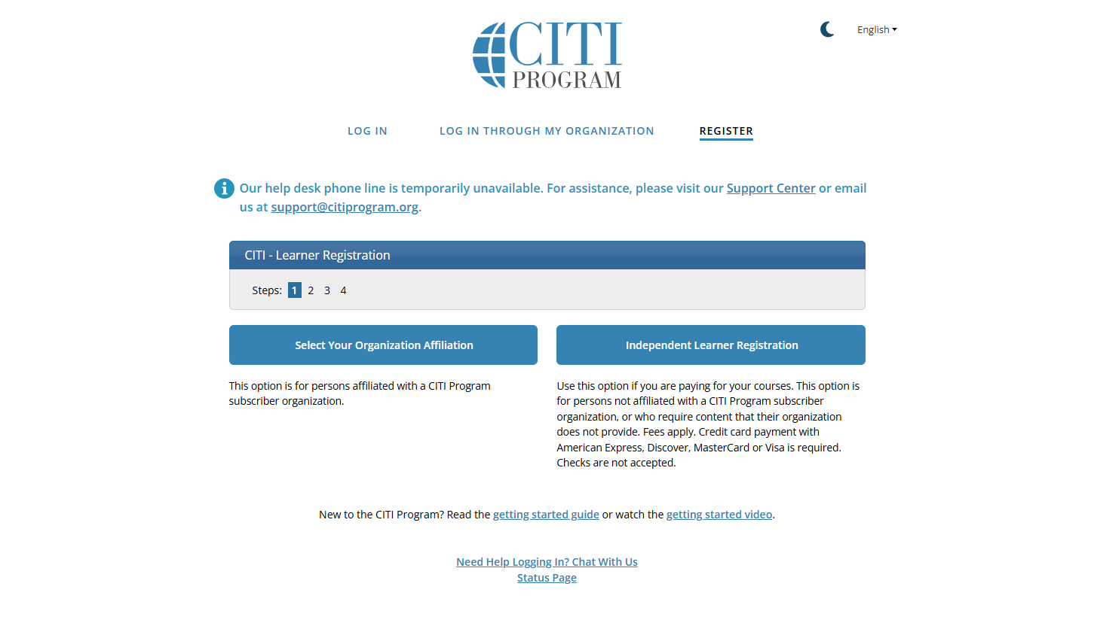
From Select Your Organizational Affiliation, select University Medical Center of Southern Nevada.

Slide 9
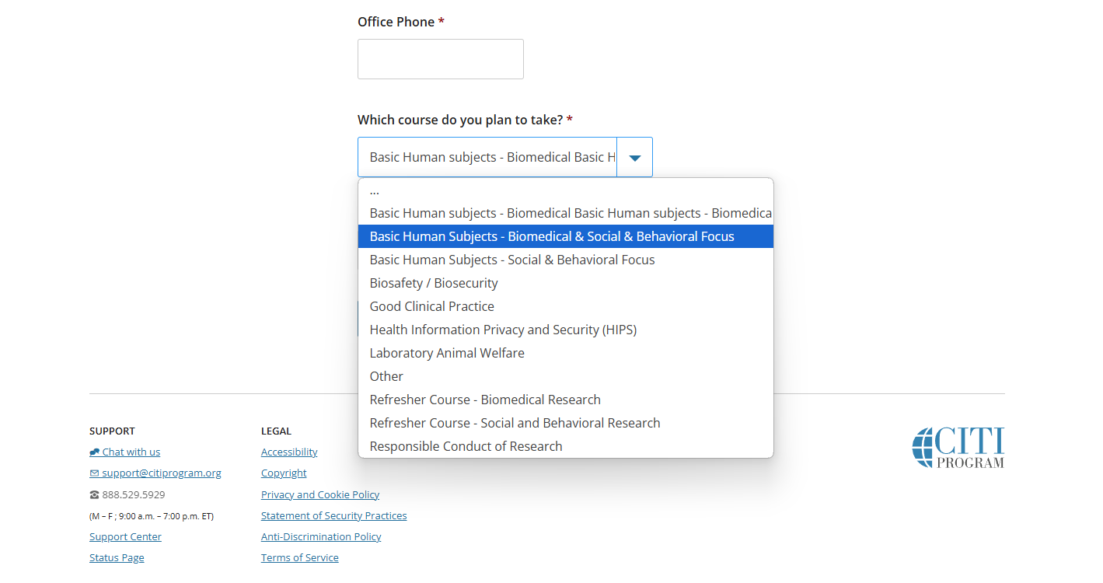
Complete the remaining registration questions. Select
Basic Human Subjects - Biomedical & Social & Behavioral Focus.

Slide 10
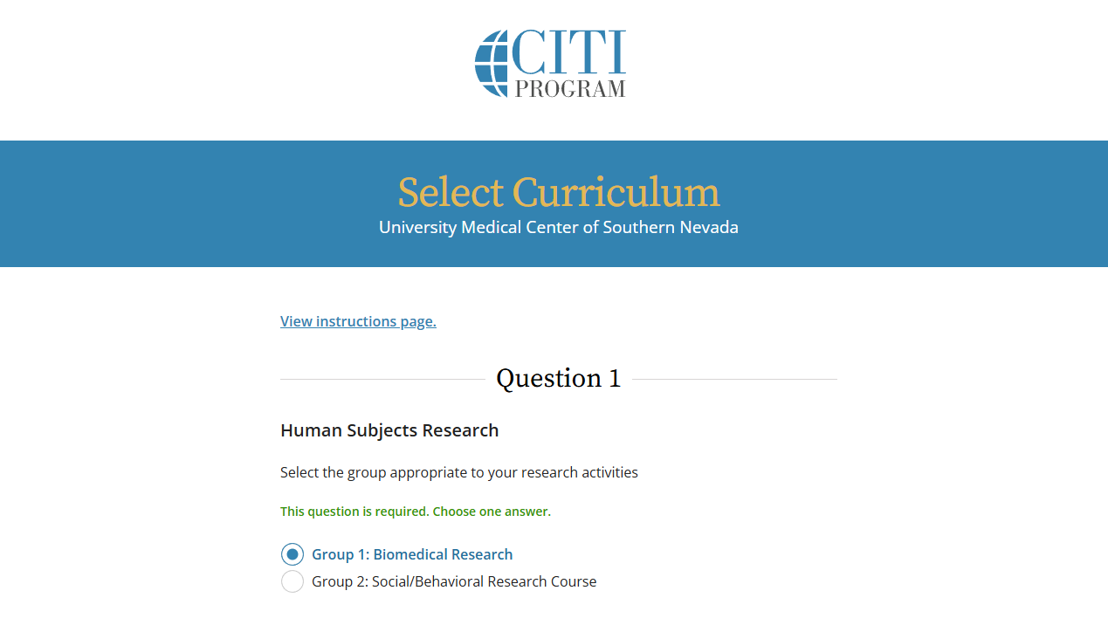
Select Biomedical Research Group

Slide 11
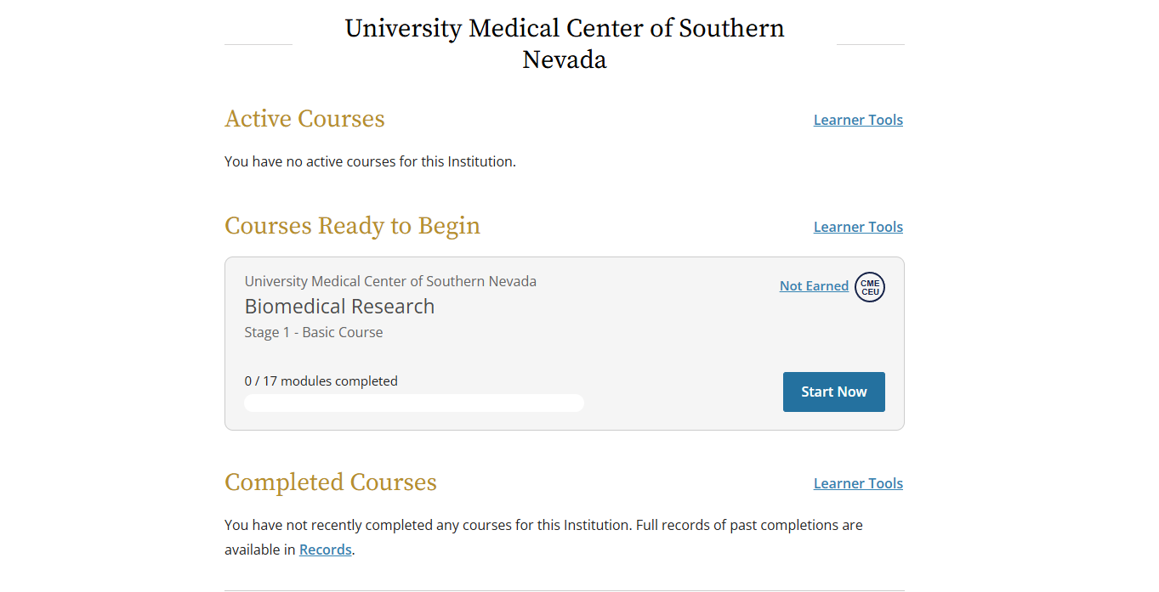
Click on Start Now to start your course.
You only need to complete the courses in the curriculum assigned to you:
Biomedical Research – Basic Course
Good Clinical Practice (GCP) – not required by UMC IRB, only if required by study sponsor

Slide 12
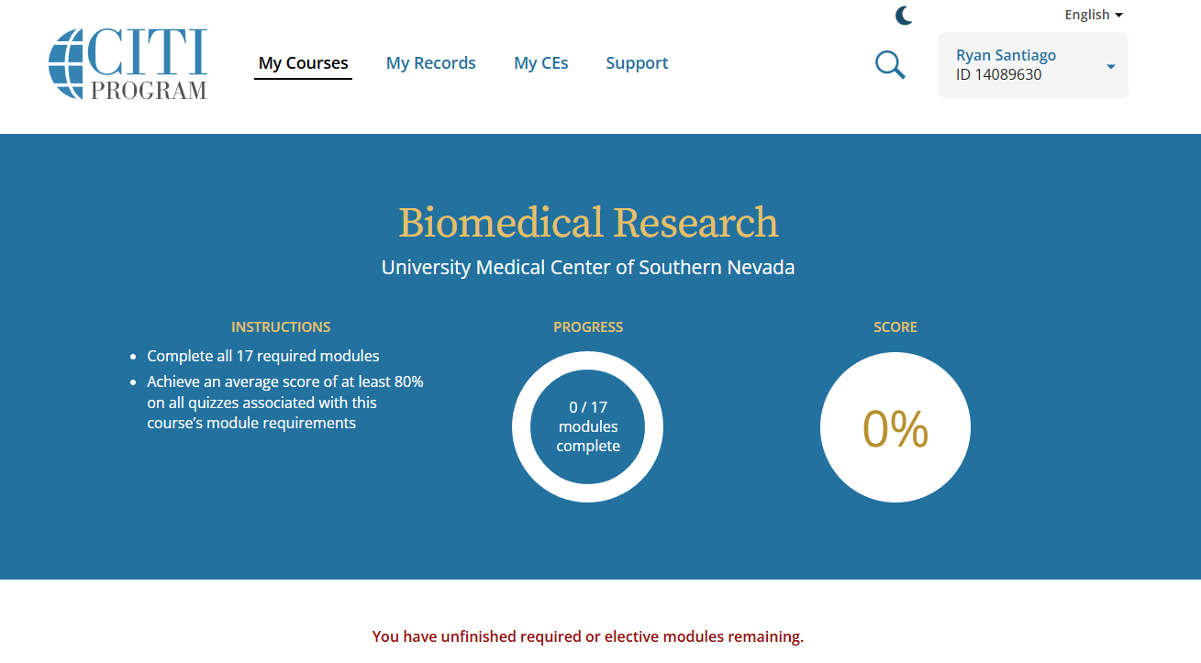
Complete all the modules. Once you have completed all the modules, you will be prompted to print out a copy of your certification for your own records.

Slide 13
To ensure that you have registered with the appropriate institution and have completed all the required modules, please email Robert.Bimbi@umcsn.com after you have completed the course.

